Slide 1
Absolute Value Functions and Transformations
By Tristen Billerbeck

Slide 2
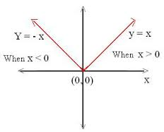
Absolute Value Functions
$f\left(x\right)= \left|x\right|$ is an absolute value function.
When x is positive, x is positive on the x-axis and $f\left(x\right)$ is positive.
When x is zero, x is zero on the x-axis and $f\left(x\right)$ is zero.
When x is negative, x is negative on the x-axis and $f\left(x\right)$ is positive.
This graph is a parent function.
(0, 0) is the vertex.

Slide 3
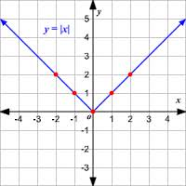
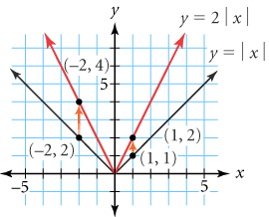
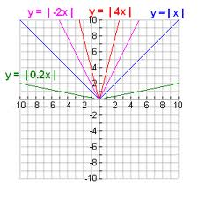
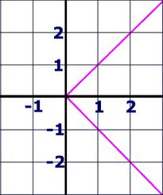
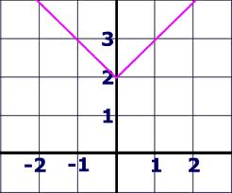
Transformations
Parent functions can be transformed by:
Size
Shape
Position
Orientation

Slide 4
Translation
A translation is a transformation that shifts a graph horizontally and/or vertically, but does not change its size, shape, or orientation.
Given the parent function: $f\left(x\right)= \left|x\right|$
Its translation would be: $f\left(x\right)= \left|x−h\right|+k$
Where h is the horizontal translation and
Where k is the vertical translation
Where (h, k) is the vertex.

Slide 5
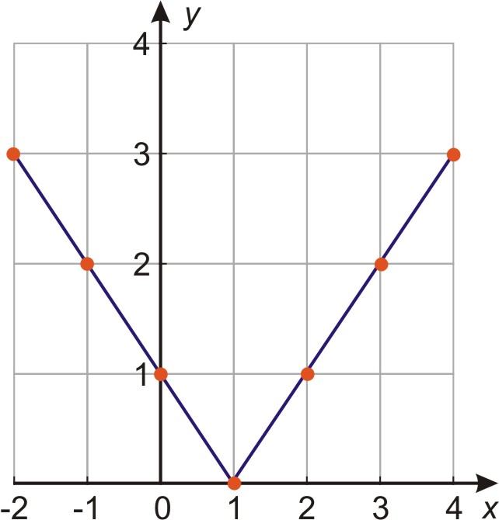
Horizontal Translation
When the parent graph only moves on the x-axis:
$f\left(x\right)= \left|x−1\right|$ + 0
$f\left(x\right)= \left|x−1\right|$
What is the vertex?
(1, 0)

Slide 6
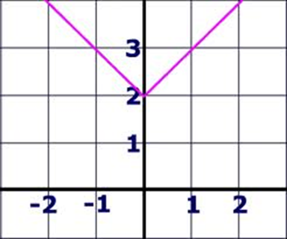
Vertical Translation
When the parent graph only moves on the y-axis:
$f\left(x\right)= \left|x−0\right|$ + 2
$f\left(x\right)= \left|x\right|$ + 2
What is the vertex?
(0, 2)

Slide 7
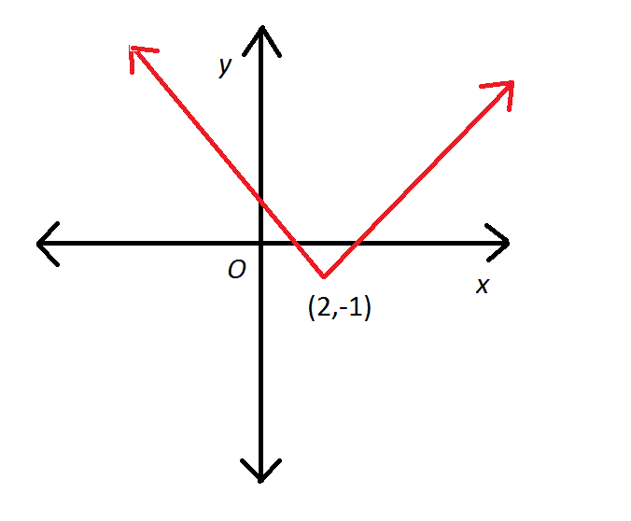
Horizontal and Vertical Translation
When the parent graph moves on both the x-axis and y-axis:
$f\left(x\right)= \left|x−2\right|$ + (-1)
$f\left(x\right)= \left|x −2\right|$ -1
What is the vertex?
(2, -1)

Slide 8
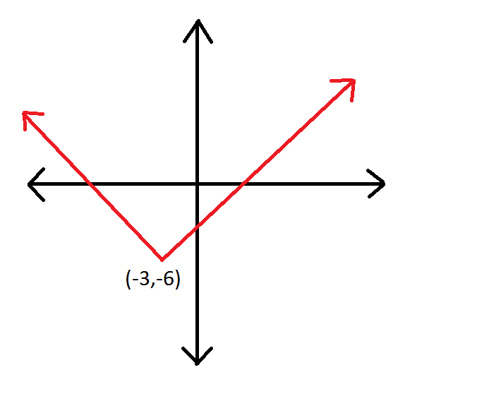
Example
What is the equation for this graph?
$f\left(x\right)= \left|x−(−3)\right|$ + (-6)
$f\left(x\right)= \left|x+3\right|$ - 6
What is the vertex?
(-3, -6)

Slide 9
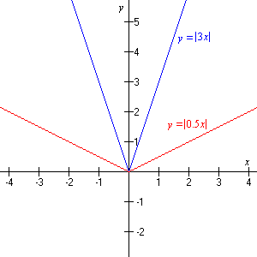
Stretches and Shrinks
When the equation is $f\left(x\right)=a\left|x\right|$ and a $≠$ 0, it is a vertical stretch or shrink
For $\left|a\right|>1$the graph is vertically stretched or elongated (narrower than the parent graph $f\left(x\right)= \left|x\right|$)
For $\left|a\right|<1$the graph is vertically shrunk, or compressed (wider than the parent graph $f\left(x\right)= \left|x\right|$)

Slide 10
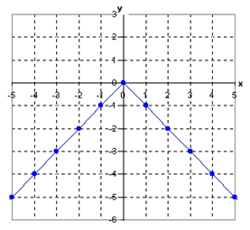
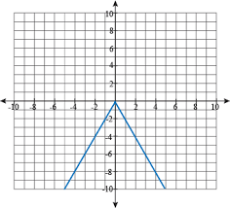
Reflections
When a = -1, the graph of $f\left(x\right)=a\left|x\right|$ is a reflection about the x-axis.
When a < 0, but a $≠$ -1, the graph is vertically stretched or shrunk with a reflection about the x-axis.

Slide 11
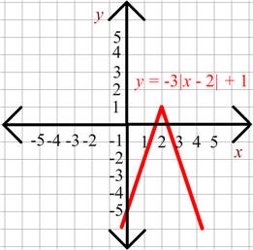
Multiple Transformations
A multiple transformation would translate and stretch, shrink, and/or reflect the parent graph $f\left(x\right)=\left|x\right|$
The equation is $f\left(x\right)=a\left|x−h\right|+k$
For this graph the equation is:
$f\left(x\right)=−3\left|x−2\right|+1$

Slide 12
You Try This
Graph $f\left(x\right)=\left|x−1\right|$
Graph $f\left(x\right)=\left|x\right|+2$
Graph $f\left(x\right)=\left|x−1\right|+2$
Graph $f\left(x\right)=2\left|x−1\right|+2$
Graph $f\left(x\right)=−2\left|x−1\right|+2$

