Slide 1
Scatter Plots and Best-Fitting Lines
By Tristen Billerbeck

Slide 2
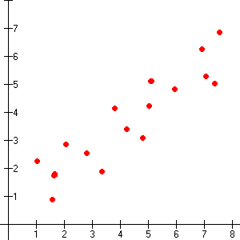
Correlations
Positive Correlation---if the graph rises (y increases as x increases)

Slide 3
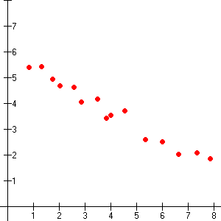
Correlations
Negative Correlation---the graph falls (as y increases, x decreases)

Slide 4
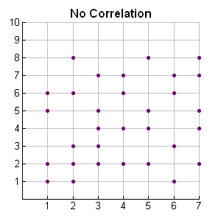
Correlations
No Correlation

Slide 5
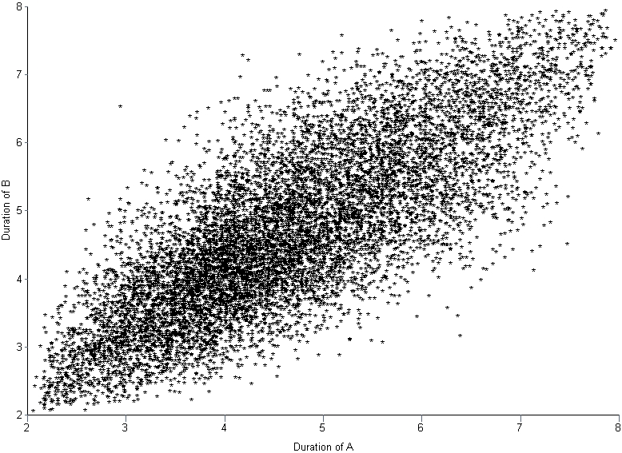
Describe Which Scatter Plot
Positive Correlation

Slide 6
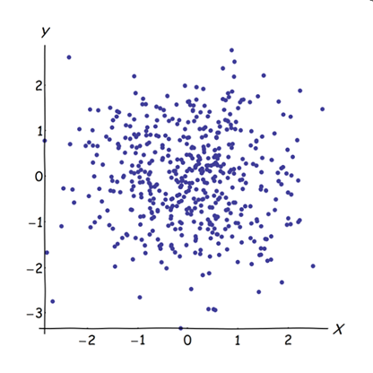
Describe Which Scatter Plot
No Correlation

Slide 7
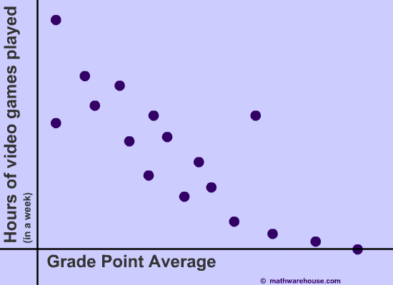
Describe Which Scatter Plot
Negative Correlation

Slide 8
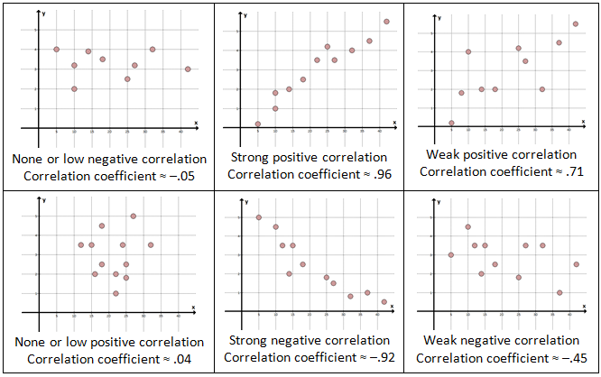
Correlation Coefficients
A correlation coefficient, denoted by r, is a number from --1 to 1 that measures how well a line fits a set of data pairs (x, y).
If r is near 1, the points lie close to a line with a positive slope.
If r is near -1, the points lie close to a line with a negative slope.
If r is 0, the points do not lie close to any line

Slide 9
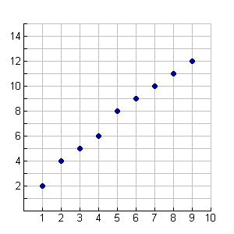
What is the approximate correlation coefficient?
Correlation coefficient is about 1.

Slide 10
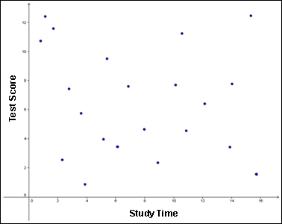
What is the approximate correlation coefficient?
Correlation coefficient is about 0.

Slide 11
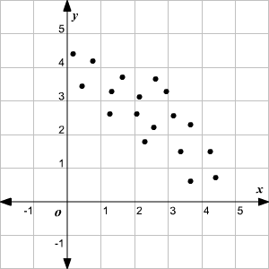
What is the approximate correlation coefficient?
The correlation coefficient is about -0.8.

Slide 12
Graphing Calculator Activity
P. 97
P. 112

Slide 13
Key Strategy
Draw the scatter plot
Sketch the line that follows the trend
Choose 2 points on the line and estimate the coordinates
Write an equation of the line that passes through the 2 points.

Slide 14
Independent Practice

