Slide 1
Graphing Linear Inequalities in 2 Variables
By Tristen Billerbeck

Slide 2
Linear Inequality Forms
$Ax+By<C$
$Ax+By≤C$
$Ax+By>C$
$Ax+By≥C$

Slide 3
Solutions
An ordered pair (x, y) is a solution of a linear inequality in two variables if the inequality is true when the values of x and y are substituted into the inequality.
Example:
Given: 2x + 5y > 12 Is (1, 3) a solution?
2(1) + 5(3) > 12
2 + 15 > 12
17 > 12
Yes, it is a solution!

Slide 4

Solutions
Given $4x−2y≥6$
Is (0, -3) a solution?
Yes: $4\left(0\right)−2\left(−3\right)≥6 0−\left(−6\right)≥6 ∴6≥6$
Is (1, 3) a solution?
No: $4\left(1\right)−2\left(3\right)≥6 4−6≥6 −2≥6$

Slide 5
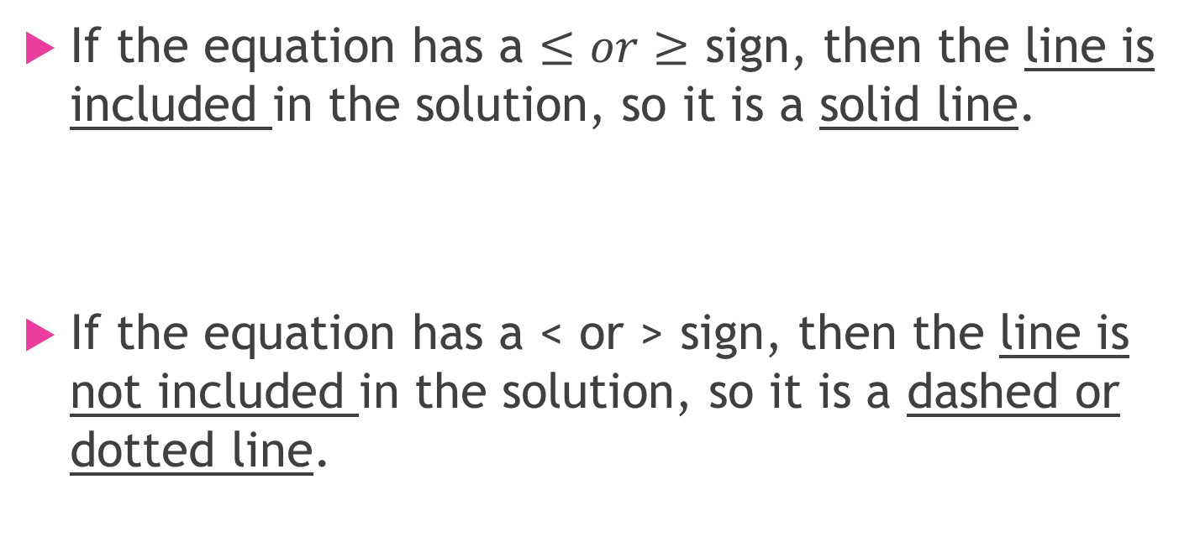
Solid Line or Dashed Line?
If the equation has a $≤or≥$ sign, then the line is included in the solution, so it is a solid line.
If the equation has a < or > sign, then the line is not included in the solution, so it is a dashed or dotted line.

Slide 6
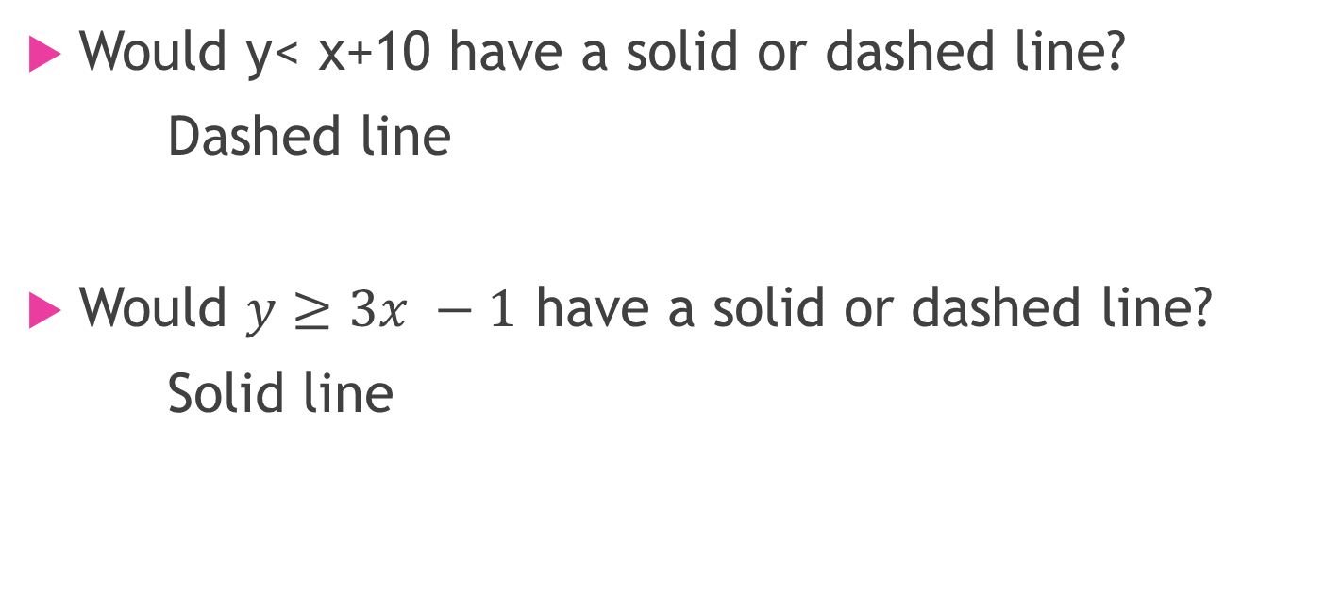
Just Checking
Would y< x+10 have a solid or dashed line?
Dashed line
Would $y≥3x −1$ have a solid or dashed line?
Solid line

Slide 7
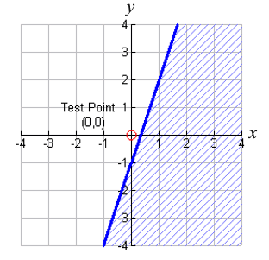
Test Points to Determine Solutions
What is a test point?
It tells us if it’s a solution or not.
If it is a solution then that’s the side of the line that is shaded, which is called a half-plane.
If it is not a solution then that’s the side of the line that is not shaded, which is also called a half-plane.
For all equations, except ones going through the origin, use (0,0) as a test point----because it’s easy to use!

Slide 8
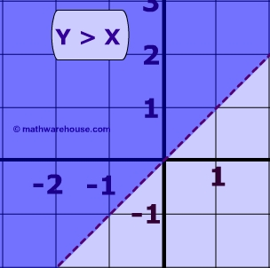
Linear Inequality Graphs

Slide 9
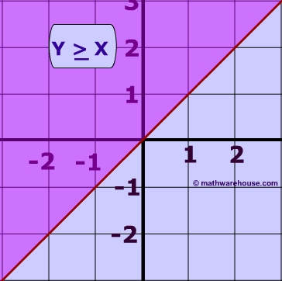
Linear Inequality Graphs

Slide 10
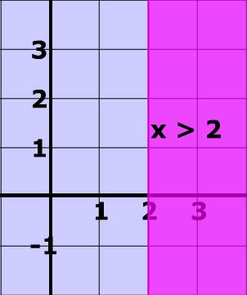
Linear Inequality Graphs

Slide 11
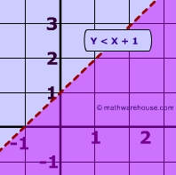
Linear Inequality Graphs

Slide 12
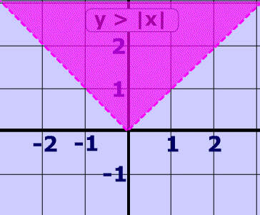
Linear Inequality Graphs

Slide 13
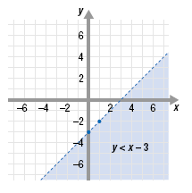
Linear Inequality Graphs
What do you think y < x – 3 would look like?
Would it have a solid or dotted line?
Would it be shaded above or below the line?

Slide 14
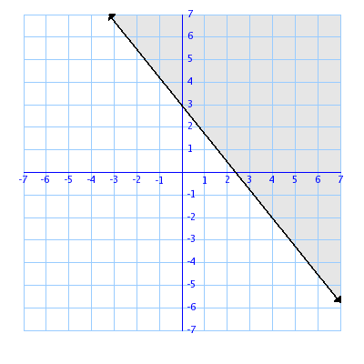
Linear Inequality Graphs
What do you think $y≻−\frac{5}{4}x+3$would look like?
Would it have a solid or dotted line?
Would it be shaded above or below the line?

Slide 15
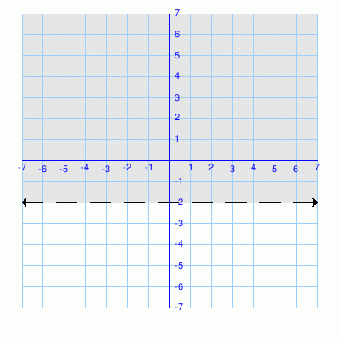
Linear Inequality Graphs
What do you think y > -2 would look like?
Would it have a solid or dotted line?
Would it be shaded above or below the line?

Slide 16
Real Life
Let’s say that Esmeralda had to do twice as much homework in math as usual and also had history homework to do. She only had 2 hours to study at night. What would be the inequality to represent how quickly she had to finish her homework?
If x = math homework time and y = history homework time, then
$2x+y≤2$
If Esmeralda usually had ½ hour of math and ¾ hours of history homework, would she get it done in time?
$2\left(\frac{1}{2}\right)+\frac{3}{4}≤2 1+\frac{3}{4}≤2 1\frac{3}{4}≤2 ∴she does have enough time!$

