Slide 1
Evaluating and Simplifying Algebraic Expressions
By Tristen Billerbeck

Slide 2
Warm Up
Find the product.
1. 5 • 5 • 5 • 5
625
2. 3 • 3 • 3
27
3. (–7) • (–7) • (–7)
–343
4. 9 • 9
81

Slide 3
If a number is in exponential form, the exponent represents how many times the base is to be used as a factor. A number produced by raising a base to an exponent is called a power. 27 and 3³ are equivalent.
Base
Exponent
2
7

Slide 4
Write in exponential form.
A. 4 • 4 • 4 • 4
Identify how many times 4 is a factor.
4 • 4 • 4 • 4 = 4⁴
B. (–6) • (–6) • (–6)
Identify how many times –6 is a factor.
(–6) • (–6) • (–6) = (–6)³
Reading Math
Read (–6)³ as “–6 to the 3rd" or "–6 cubed”.

Slide 5
Write in exponential form.
C. 5 • 5 • d • d • d • d
Identify how many times 5 and d are each used as a factor.
5 • 5 • d • d • d • d = 5²d⁴

Slide 6
Caution!
The expression (–4)⁴ is not the same as the expression –4⁴. Think of –4⁴ as –1 ● 4⁴.
By the order of operations, you must evaluate the exponent before multiplying by –1.

Slide 7
Check It Out!
Evaluate.
C. (–5)²
(–5)²
= (–5) • (–5)
Find the product.
= 25
D. –9⁴
–9⁴ = –(9 • 9 • 9 • 9)
Find the product. Then make the answer negative.
= –6,561

Slide 8
Evaluate each expression for the given value of x.
1. 2x + 3; x = 2 2. x² + 4; x = –3
3. –4x – 2; x = –1 4. 7x² + 2x; x = 3
Identify the coefficient in each term.
5. 4x³ 6. y³
7. 2n⁷ 8. –s⁴
7
13
2
69
4
1
2
–1

Slide 9
A monomial is a number, a variable, or a product of numbers and variables with whole-number exponents. A monomial may be a constant or a single variable.
The degree of a monomial is the sum of the exponents of the variables. A constant has degree 0.

Slide 10
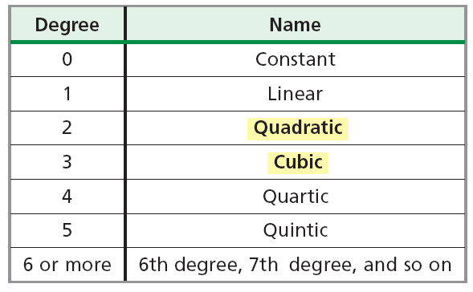
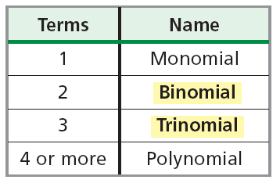
Some polynomials have special names based on their degree and the number of terms they have.

Slide 11
Write the polynomial in standard form. Then give the leading coefficient.
6x – 7x⁵ + 4x² + 9
Find the degree of each term. Then arrange them in descending order:
6x – 7x⁵ + 4x² + 9
–7x⁵ + 4x² + 6x + 9
Degree
1
5
2
0
5
2
1
0
The standard form is
–7x⁵ + 4x² + 6x + 9.
The leading
coefficient is –7.

Slide 12
Simplify each expression by combining like terms.
1. 4x + 2x
2. 3y + 7y
3. 8p – 5p
4. 5n + 6n²
Simplify each expression.
5. 3(x + 4)
6. –2(t + 3)
7. –1(x² – 4x – 6)
6x
10y
3p
not like terms
3x + 12
–2t – 6
–x² + 4x + 6

Slide 13
Add or subtract.
A. 12p³ + 11p² + 8p³
12p³ + 11p² + 8p³
Identify like terms.
12p³ + 8p³ + 11p²
Rearrange terms so that like terms are together.
20p³ + 11p²
Combine like terms.
B. 5x² – 6 – 3x + 8
5x² – 6 – 3x + 8
Identify like terms.
Rearrange terms so that like terms are together.
5x² – 3x + 8 – 6
5x² – 3x + 2
Combine like terms.

Slide 14
Subtract.
(–10x² – 3x + 7) – (x² – 9)
(–10x² – 3x + 7) + (–x² + 9)
Rewrite subtraction as addition of the opposite.
(–10x² – 3x + 7) + (–x² + 9)
Identify like terms.
–10x² – 3x + 7
Use the vertical method.
–x² + 0x + 9
Write 0x as a placeholder.
–11x² – 3x + 16
Combine like terms.

