Slide 1
Direct Variation
By Tristen Billerbeck

Slide 2
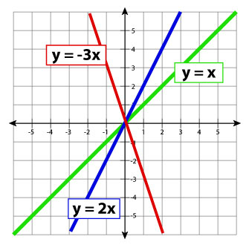
Direct variation
Equation:
The equation y = ax represents direct variation between x and y is said to vary directly with x. The nonzero constant a is called the constant of variation.
Graph:
The graph of a direct variation equation y = ax is a line with slope a and y-intercept (0, 0).
The family of direct variation graphs consists of lines through the origin, such as those shown.

Slide 3
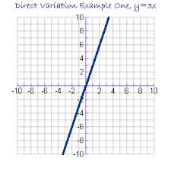
Example 1
Write and graph a direct variation equation that has a solution of (3, 9).
Solution: y = ax
9 = a(3)
3 3
a = 3
Therefore: y = 3x

Slide 4
Example 2
Hooke’s Law states that the distance d a spring stretches varies directly with the force f that is applied to it.
Suppose a spring stretches 25 inches when a force of 15 pounds is applied. What is the equation that relates d to f?
d = (25 inches)f
(15 pounds)
Therefore: d = 5/3f
What distance will the spring stretch if 18 pounds is applied?
d = 5(18)
3
d = 30 inches

Slide 5
Example 3
If a waitress receives a $4.50 tip for a bill of $30, what is the direct variation (or tip percentage)?
$4.50 = a($30)
Divide each side by $30.
a = 0.15 (which is a 15% tip)
Therefore the equation for a 15% tip is y = (.15)x.
What tip would the waitress make on a bill for $45?
y = (.15)($45)
y = $6.75

Slide 6
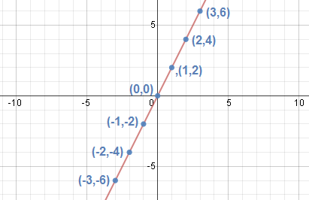
Example 4
Given the following table for the slope of a hillside
from a home that is perched in the middle of it:
Ratio 2 2 2 undefined 2 2 2 (Direct Variation)
Set up the ratios of y/x (which is the constant of variation, if it’s the same).
If the ratios are the same, then this is a direct variation.
If the ratios are not the same, then this is not a direct variation.
y | -6 | -4 | -2 | 0 | 2 | 4 | 6
x | -3 | -2 | -1 | 0 | 1 | 2 | 3

Slide 7
You Try this:
What is a graph that has a direct variation and a solution of (-2, 6)?
Y = -3x
What is the direct variation for f = ma, if the f = 8 pounds and
a = 4 feet per second squared?
f = 2a
Is this a direct variation?
Yes
Distance = 3(Time)
Distance (m) | 12 | 18 | 27 | 36
Time (s) | 4 | 6 | 9 | 12

