Slide 1
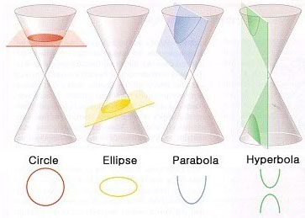
Section 11.6 – Conic Sections
Conics – curves that are created by the intersection of a plane and a right circular cone.

Slide 2
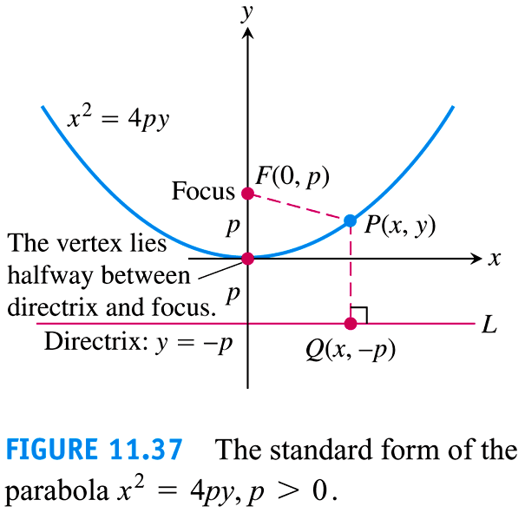
Section 11.6 – Conic Sections
Parabola – set of points in a plane that are equidistant from a fixed point (d(F, P)) and a fixed line (d (P, Q)).
Focus - the fixed point of a parabola.
Directrix - the fixed line of a parabola.
Axis of Symmetry
Axis of Symmetry – The line that goes through the focus and is perpendicular to the directrix.
Vertex – the point of intersection of the axis of symmetry and the parabola.
Directrix

Slide 3
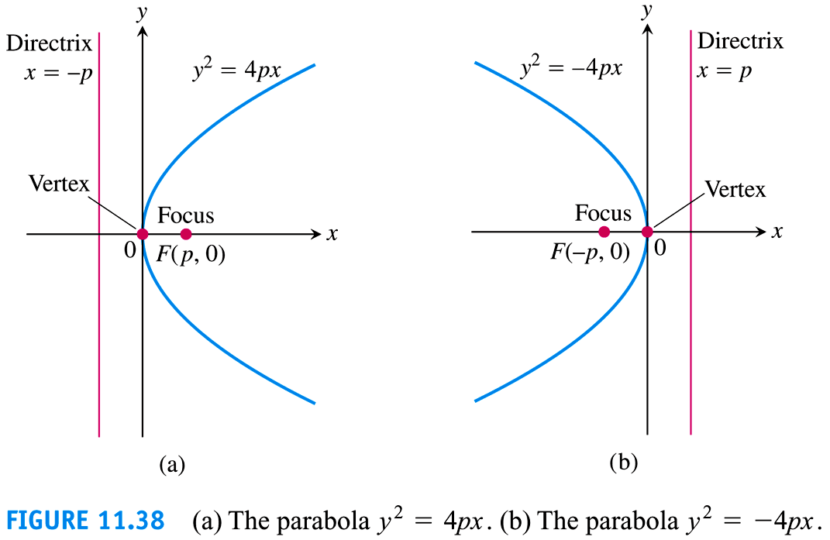
Section 11.6 – Conic Sections
Parabolas
$$y^{2}=4px$$
$$x^{2}=4py$$
$${(y−k)}^{2}=4p(x−h)$$
$${(x−h)}^{2}=4p(y−k)$$

Slide 4
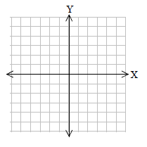
Section 11.6 – Conic Sections
Find the vertex, focus and the directrix
$$x^{2}=16y$$
$$parabola, opens up$$
$$vertex:(0,0)$$
•
$$find p$$
•
$$16=4p$$
$$p=4$$
$$y=−4$$
$$focus$$
$$(0,0+p)$$
$$(0,4)$$
$$directrix$$
$$y=0−p$$
$$y=−4$$

Slide 5
Section 11.6 – Conic Sections
Find the vertex and the focus given: $y^{2}+10y+x+20=0$
$$y^{2}+10y+x+20=0$$
$$vertex$$
$$y^{2}+10y=−x−20$$
$$(5,−5)$$
$$complete the square$$
$$find p$$
$$\frac{10}{2}=5$$
$$5^{2}=25$$
$$1=4p$$
$$y^{2}+10y+25=−x−20+25$$
$$p=\frac{1}{4}$$
$${(y+5)}^{2}=−x+5$$
$$focus$$
$${(y+5)}^{2}=−(x−5)$$
$$(5−\frac{1}{4},−5)$$
$$opens left$$
$$(4\frac{3}{4},−5)$$
$$x=5\frac{1}{4}$$
$$directrix$$
$$x=5+\frac{1}{4}$$
$$x=5\frac{1}{4}$$
•
•

Slide 6
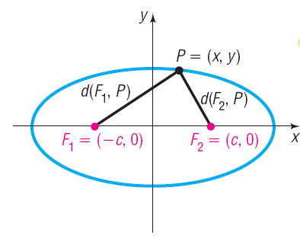
Section 11.6 – Conic Sections
Ellipse – a set of points in a plane whose sum of the distances from two fixed points is a constant.
$$d\left(F_{1},P\right)+d\left(F_{2},P\right)=constant$$
•
Q
$$d\left(F_{1},Q\right)+d\left(F_{2},Q\right)=$$
$$constant$$
$$=d\left(F_{1},P\right)+d\left(F_{2},P\right)$$

Slide 7
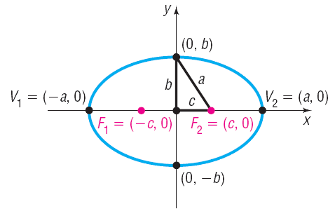
Section 11.6 – Conic Sections
Foci – the two fixed points, $F_{1} and F_{2}$, whose distances from a single point on the ellipse is a constant.
Major axis – the line that contains the foci and goes through the center of the ellipse.
Vertices – the two points of intersection of the ellipse and the major axis, $V_{1} and V_{2}$ .
Foci
Minor axis – the line that is perpendicular to the major axis and goes through the center of the ellipse.
Major axis
Minor axis
Vertices

Slide 8
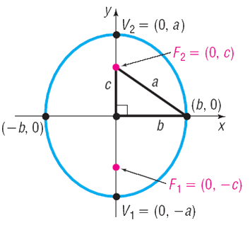
Section 11.6 – Conic Sections
Equation of an Ellipse Centered at the Origin
$$\frac{x^{2}}{a^{2}}+\frac{y^{2}}{b^{2}}=1 where a>b$$
$$\frac{x^{2}}{b^{2}}+\frac{y^{2}}{a^{2}}=1 where a>b$$

Slide 9
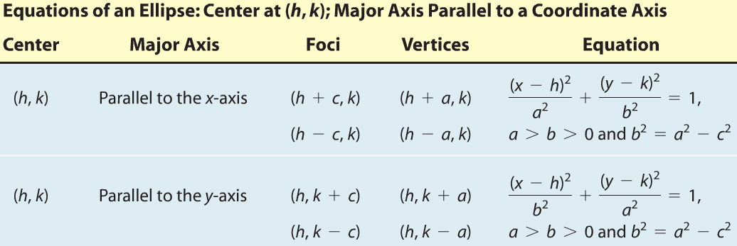
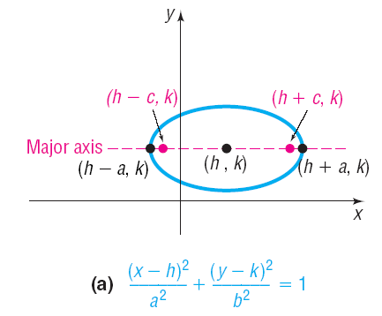
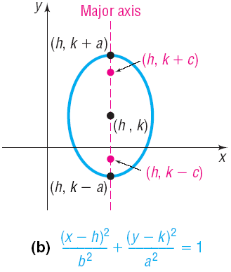
Section 11.6 – Conic Sections
Equation of an Ellipse Centered at a Point

Slide 10
Section 11.6 – Conic Sections
Find the vertices for the major and minor axes, and the foci using the following equation of an ellipse.
$$\frac{x^{2}}{25}+\frac{y^{2}}{9}=1$$
Major axis is along the x-axis
Vertices of major axis:
$$a^{2}=25$$
$$a=±5$$
$$\left(−5,0\right) and (5,0)$$
Vertices of the minor axis
•
$$b^{2}=9$$
$$b=±3$$
$$\left(0,3\right) and (0,−3)$$
•
•
•
•
Foci
•
$$c^{2}=a^{2}−b^{2}$$
$$c^{2}=25−9$$
$$c^{2}=16$$
$$c=±4$$
$$\left(−4,0\right) and (4,0)$$

Slide 11
Section 11.6 – Conic Sections
Find the vertices for the major and minor axes, and the foci using the following equation of an ellipse.
$${4x}^{2}+9y^{2}=36$$
$$\frac{{4x}^{2}}{36}+\frac{{9y}^{2}}{36}=1$$
$$\frac{x^{2}}{9}+\frac{y^{2}}{4}=1$$
Major axis is along the x-axis
Vertices of major axis:
$$a^{2}=9$$
$$a=±3$$
$$\left(−3,0\right) and (3,0)$$
•
Vertices of the minor axis
•
•
•
•
$$b^{2}=4$$
$$b=±2$$
$$\left(0,2\right) and (0,−2)$$
•
Foci
$$c^{2}=a^{2}−b^{2}$$
$$c^{2}=9−4$$
$$c^{2}=5$$
$$c=±\sqrt{5}$$
$$\left(−\sqrt{5},0\right) and (\sqrt{5},0)$$

Slide 12
Section 11.6 – Conic Sections
Find the center, the vertices of the major and minor axes, and the foci using the following equation of an ellipse.
$${16x}^{2}+4y^{2}+96x−8y+84=0$$
$${16x}^{2}+96x+4y^{2}−8y=−84$$
$${16(x}^{2}+6x)+4(y^{2}−2y)=−84$$
$$\frac{6}{2}=3$$
$$\frac{−2}{2}=−1$$
$$3^{2}=9$$
$${(−1)}^{2}=1$$
$${16(x}^{2}+6x+9)+4\left(y^{2}−2y+1\right)=−84+144+4$$
$$16{(x+3)}^{2}+4{(y−1)}^{2}=64$$
$$\frac{{16(x+3)}^{2}}{64}+\frac{{4(y−1)}^{2}}{64}=1$$
$$\frac{{(x+3)}^{2}}{4}+\frac{{(y−1)}^{2}}{16}=1$$

Slide 13
Section 11.6 – Conic Sections
$$\frac{{(x+3)}^{2}}{4}+\frac{{(y−1)}^{2}}{16}=1$$
Center:
$$(−3,1)$$
Major axis: $x=−3 (vertical)$
Foci
Vertices:
$$a^{2}=16$$
$$a=±4$$
$$c^{2}=a^{2}−b^{2}$$
$$\left(−3,1−4\right) and (−3,1+4)$$
$$c^{2}=16−4$$
$$\left(−3,−3\right) and (−3,5)$$
$$c^{2}=12$$
Minor axis: $y=1 (horizontal)$
$$c=±2\sqrt{3}$$
Vertices of the minor axis
$$\left(−3,1−2\sqrt{3}\right) and (−3,1+2\sqrt{3})$$
$$b^{2}=4$$
$$b=±2$$
$$\left(−3,−2.464\right) and (−3, 4.464)$$
$$\left(−3−2,1\right) and (−3+2,1)$$
$$\left(−5,1\right) and (−1,1)$$

Slide 14
Section 11.6 – Conic Sections
$$\frac{{(x+3)}^{2}}{4}+\frac{{(y−1)}^{2}}{16}=1$$
Center:
$$(−3,1)$$
Major axis vertices:
$$\left(−3,−3\right) and (−3,5)$$
•
•
Minor axis vertices:
$$\left(−5,1\right) and (−1,1)$$
•
•
•
Foci
•
$$\left(−3,−2.464\right) and (−3,4.464)$$
•

Slide 15
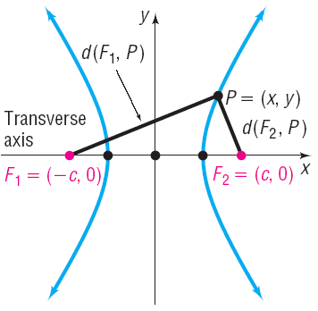
Section 11.6 – Conic Sections
Hyperbola – a set of points in a plane whose difference of the distances from two fixed points is a constant.
$$d\left(F_{1},P\right)−d\left(F_{2},P\right)=constant=±2a$$
Q
•
$$d\left(F_{1},Q\right)−d\left(F_{2},Q\right)=$$
$$constant$$
$$=±2a$$

Slide 16
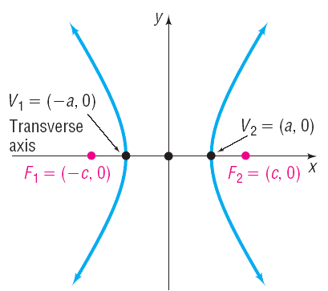
Section 11.6 – Conic Sections
Foci – the two fixed points, $F_{1} and F_{2}$, whose difference of the distances from a single point on the hyperbola is a constant.
Transverse axis – the line that contains the foci and goes through the center of the hyperbola.
Center
Center – the midpoint of the line segment between the two foci.
Vertices – the two points of intersection of the hyperbola and the transverse axis, $V_{1} and V_{2}$ .
•
Conjugate axis – the line that is perpendicular to the transverse axis and goes through the center of the hyperbola.
Conjugate axis

Slide 17
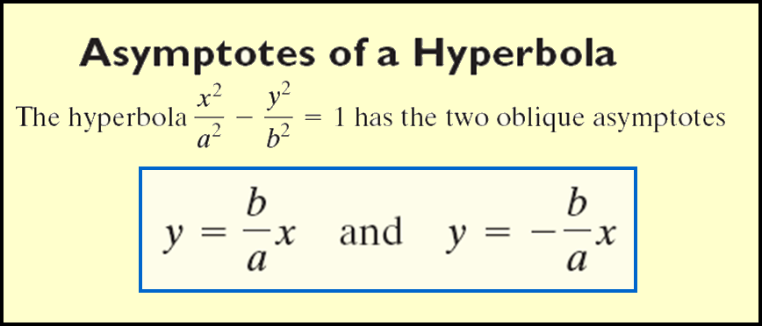
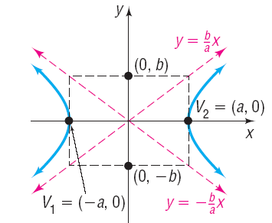
Section 11.6 – Conic Sections
Equation of an Ellipse Centered at the Origin

Slide 18
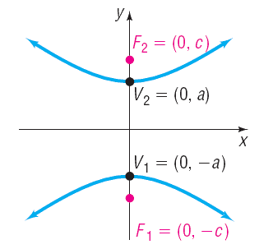
Section 11.6 – Conic Sections
Equation of a Hyperbola Centered at the Origin

Slide 19
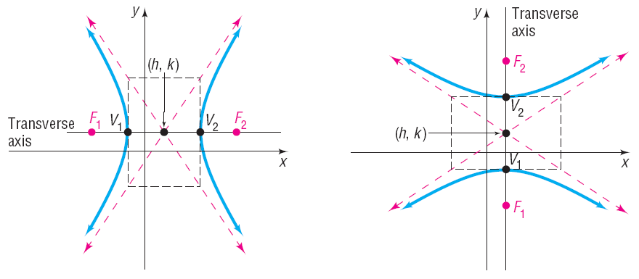
Section 11.6 – Conic Sections
Equation of a Hyperbola Centered at a Point

Slide 20
Section 11.6 – Conic Sections
Identify the direction of opening, the coordinates of the center, the vertices, and the foci. Find the equations of the asymptotes and sketch the graph.
•
$$\frac{y^{2}}{4}−\frac{x^{2}}{16}=1$$
Center: $(0,0)$
•
•
•
Vertices of transverse axis:
•
$$a^{2}=4$$
$$a=±2$$
$$\left(0,−2\right) and (0,2)$$
•
Foci
Equations of the Asymptotes
$$b^{2}=16$$
$$b=±4$$
$$\left(−4,0\right) and (4,0)$$
$$y−y_{1}=±\frac{a}{b}(x−x_{1})$$
$$b^{2}=c^{2}−a^{2}$$
$$16=c^{2}−4$$
$$c^{2}=20$$
$$c=±2\sqrt{5}$$
$$y−0=±\frac{2}{4}(x−0)$$
$$\left(0,−2\sqrt{5}\right) and (0,2\sqrt{5})$$
$$y=±\frac{1}{2}x$$

Slide 21
Section 11.6 – Conic Sections
Find the center, the vertices of the transverse axis, the foci and the equations of the asymptotes using the following equation of a hyperbola.
$$y^{2}−4x^{2}−72x+10y−399=0$$
$$y^{2}+10y−4x^{2}−72x=399$$
$$\left(y^{2}+10y\right)−{4(x}^{2}+18x)=399$$
$$\frac{10}{2}=5$$
$$\frac{18}{2}=9$$
$$5^{2}=25$$
$$9^{2}=81$$
$$\left(y^{2}+10y+25\right)−4{(x}^{2}+18x+81)=399+25−324$$
$${(y+5)}^{2}−4{(x+9)}^{2}=100$$
$$\frac{{(y+5)}^{2}}{100}−\frac{{4(x+9)}^{2}}{100}=1$$
$$\frac{{(y+5)}^{2}}{100}−\frac{{(x+9)}^{2}}{25}=1$$
Opening up/down

Slide 22
Section 11.6 – Conic Sections
Find the center, the vertices of the transverse axis, the foci and the equations of the asymptotes using the following equation of a hyperbola.
$$y^{2}−4x^{2}−72x+10y−399=0$$
$$\frac{{(y+5)}^{2}}{100}−\frac{{(x+9)}^{2}}{25}=1$$
Foci:
$$b^{2}=c^{2}−a^{2}$$
$$25=c^{2}−100$$
Center: $(−9,−5)$
$$c^{2}=125$$
$$c=\sqrt{125}=5\sqrt{5}$$
$$\left(−9,−5−5\sqrt{5}\right) and (−9,−5+5\sqrt{5})$$
Vertices:
$$\left(−9,−16.18\right) and (−9,6.18)$$
$$a^{2}=100$$
$$a=10$$
$$\left(−9,−5−10\right)and (−9,−5+10)$$
$$\left(−9,−15\right)and (−9,5)$$

Slide 23
Section 11.6 – Conic Sections
Find the center, the vertices of the transverse axis, the foci and the equations of the asymptotes using the following equation of a hyperbola.
$$y^{2}−4x^{2}−72x+10y−399=0$$
$$\frac{{(y+5)}^{2}}{100}−\frac{{(x+9)}^{2}}{25}=1$$
Equations of the Asymptotes
Center: $(−9,−5)$
$$a=10$$
$$b=5$$
$$y−y_{1}=±\frac{a}{b}(x−x_{1})$$
$$y−(−5)=±\frac{10}{5}(x−(−9))$$
$$y+5=±2 (x+9)$$

Slide 24
Section 11.6 – Conic Sections

