Slide 1
Graphing Quadratic Functions in Vertex and Intercept Form
By Tristen Billerbeck

Slide 2
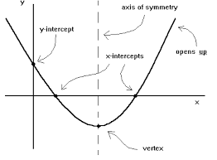
Vocabulary

Slide 3
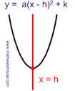
Vertex Form (h, k)
y = a(x-h)² + k
(h, k)
x =h
Axis of Symmetry

Slide 4
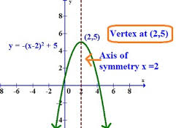
a = -1 h = 2 k = 5 a < 0 (opens down)

Slide 5
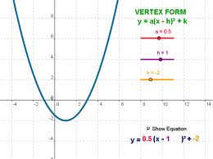

Slide 6
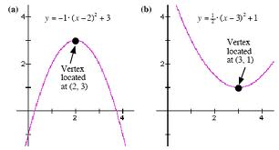

Slide 7
Example
A flying fish reaches a height of 5 feet after flying horizontally 33 feet.
What is a vertex form equation that would represent this flight if the fish started at (0, 0)?
y = a(x – 33)² + 5
y = -$\frac{5}{1089}$(x – 33)² + 5

Slide 8
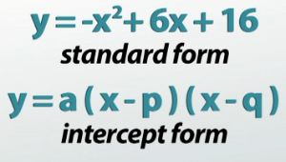

Slide 9
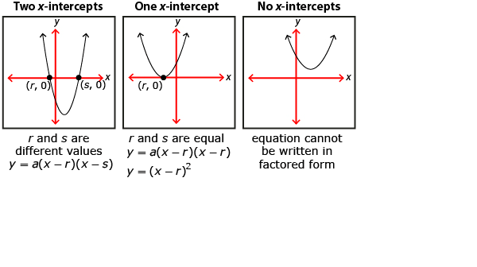
Intercept Form

Slide 10
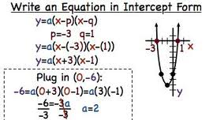

Axis of Symmetry is x = $\frac{p+q}{2}=\frac{−3+1}{2}$= $\frac{−2}{2}$ x = -1

Slide 11
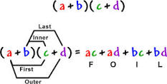
FOIL

Slide 12
Foil Example
Intercept Form: y = (x-2)(x-7)
(x-2)(x-7) = x² -7x - 2x + 14
y = x² – 9x + 14
Standard Form
F
L
I
O

Slide 13
Practice
Graph:
y = (x + 4)²
y = -(x - 2)² + 1
y = (x – 3)(x + 2)

